Slide 1
Wrangling containers with Rancher and Salt custom modules
Chris Reed
DevOps Engineer
Notes:
Intro
Hello, welcome everyone, my name is chris reed I’m from DLVR in Phoenix AZ
First year at saltconf really excited to be here with everyone
Today I’m going to talk about …. Our experience...

Slide 2
Overview
About DLVR
Day to Day with Salt
Journey into containers
Custom Module solution
Moving Forward
Notes:
Just a little overview of what we’re going to talk about ...

Slide 3
A little bit about DLVR
Notes:
So just want to start with a quick overview about who we are

Slide 4
DLVR
(pronounced “de-liv-er”)
Solutions for a multi-CDN strategy
Streaming video optimization and metrics
Intelligent CDN decision making for best video experience
DLVR provides our customers with online video delivery optimization, management, and analytics
Founded in 2014
Small startup of about 20 employees
Even smaller Operations team of 5
Global, multi-datacenter infrastructure in NA and EU
Additional infrastructure in AWS
We use Salt….a lot
Notes:
Explain a little bit more about who Matt and I are, what we do, what our roles are
So essentially DLVR does streaming video performance optimization without the need for client side addons
We create solutions for streaming video customers with mutli cdns, think of it like a load balancer for CDNs
Our algorithms constantly calculate the best cdn, transit provider, geo region, for the end user, so they get the best streaming experience and then providing those metrics back to our customer so they know who’s watching, and what CDN is performing
We’re a small startup, founded in 2014, about 20 employees and an even smaller operations teams
Ops is responsible for a global multi datacenter in north america and europe, as well as a bunch of misc AWS stuff
So as you can imagine, salt is life for us.

Slide 5
Our day to day with SaltStack

Slide 6
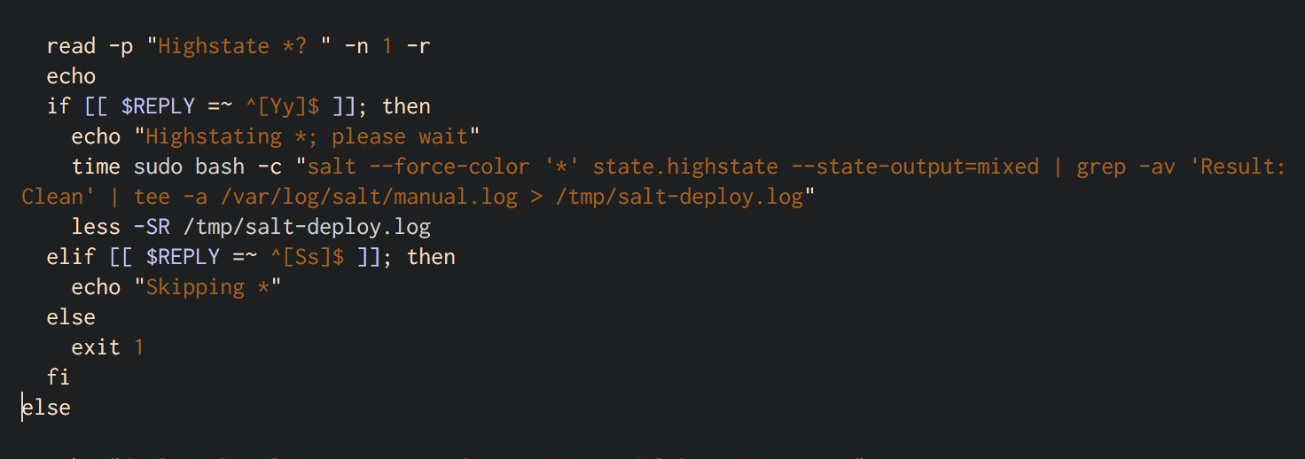
How we use SaltStack
We Salt just about everything
Debian / app installations
Config files
Lambdas
Etc, etc, etc
Daily “highstates” for deployment
Automate everything we can
Notes:
We use salt for just about everything
For our appliation deployments and upgrades
Config files, using jinja and pillar variables
Deploying aws components like lambdas and much more
Our daily “deploys” consist of highstates
We pretty much automate everything we can

Slide 7
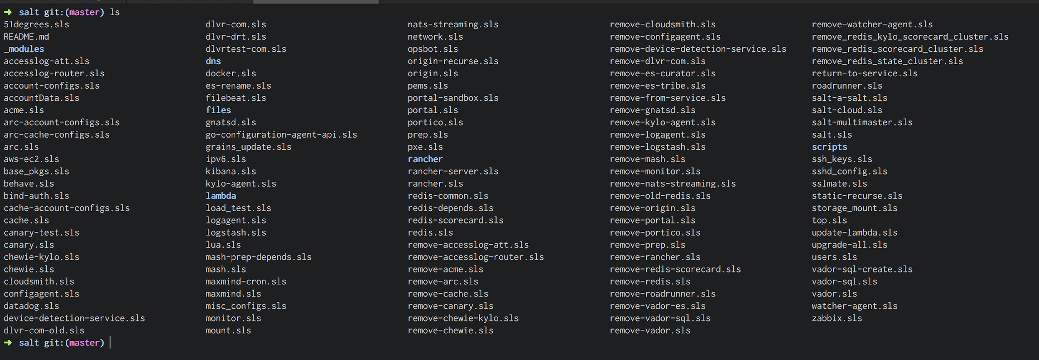
Notes:
This is just a small shot of all of our states that we use pretty much on a daily basis.
And it’s ever growing

Slide 8
All the cool kids are using containers these days
2017, we start getting container FOMO
Lots of deployment issues
Java dependency conflicts
So many development and framework environments
Ports and resources stepping on each other, getting out of control
Tied to our hardware
Notes:
Our journey into using containers started around 2017, we started to feel left out because we hadn’t taken the plunge yet.
And as you know FOMO is the best reason to make a drastic infrastructure shift
We were having lots of issues with deployment, how to cleanly rollback, how to time our upgrades, lots of “do this first, then that, then this” that wasn’t automatable
Tons of java dependency issues, developer’s using various frameworks and plugins that were stomping over each other
Some devs started using Golang quite a bit, which turned out to be a pain for Operations to try and setup environments for them to use
Ports and other resources constantly stepping on each other
And, all of this was tied to our hardware, we wanted to become more “provider agnostic”
So containers seemed like a good option to help solve most of these problems

Slide 9
OK, so Docker. Then what?
We need an orchestrator
Rules:
Use our existing data, variables, secrets, etc.
Easy to use (aka GUI)
Portable
Maintain control of hosts running containers
Not Kubernetes
Notes:
Ok so then what?
Wasn’t enough to just run `docker run ` everywhere. We need some kind of orchestration tool
Well we had a set of rules that helped guide our decision on what to use
We already had all this data sitting in salt and pillar, didn’t want to duplicated any of it
We were newbs to docker/containers, so it had to be simple to use out the gate
Again, didn’t want to be tied to *just* our hardware, so we needed an orchestration tool that can leverage other cloud providers
We wanted to maintain control over the hosts running the containers, mainly ssh access as salt makes ssh management easy
Not kubernetes…..because we like things un-complicated

Slide 10
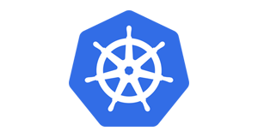


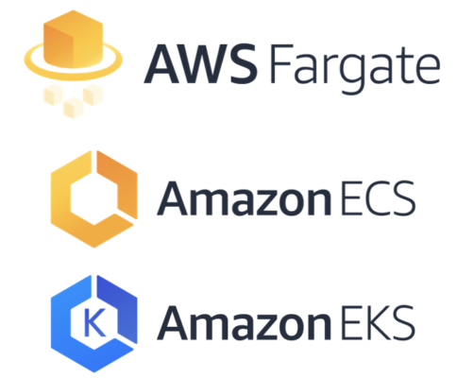
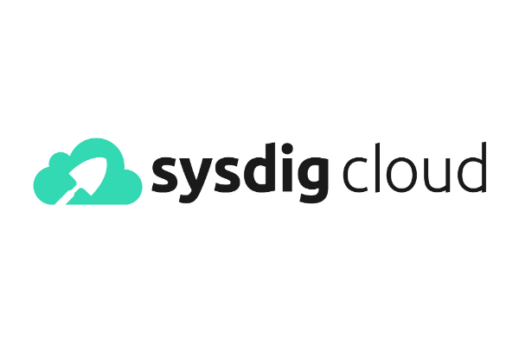

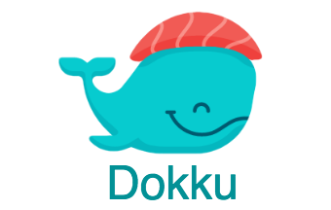


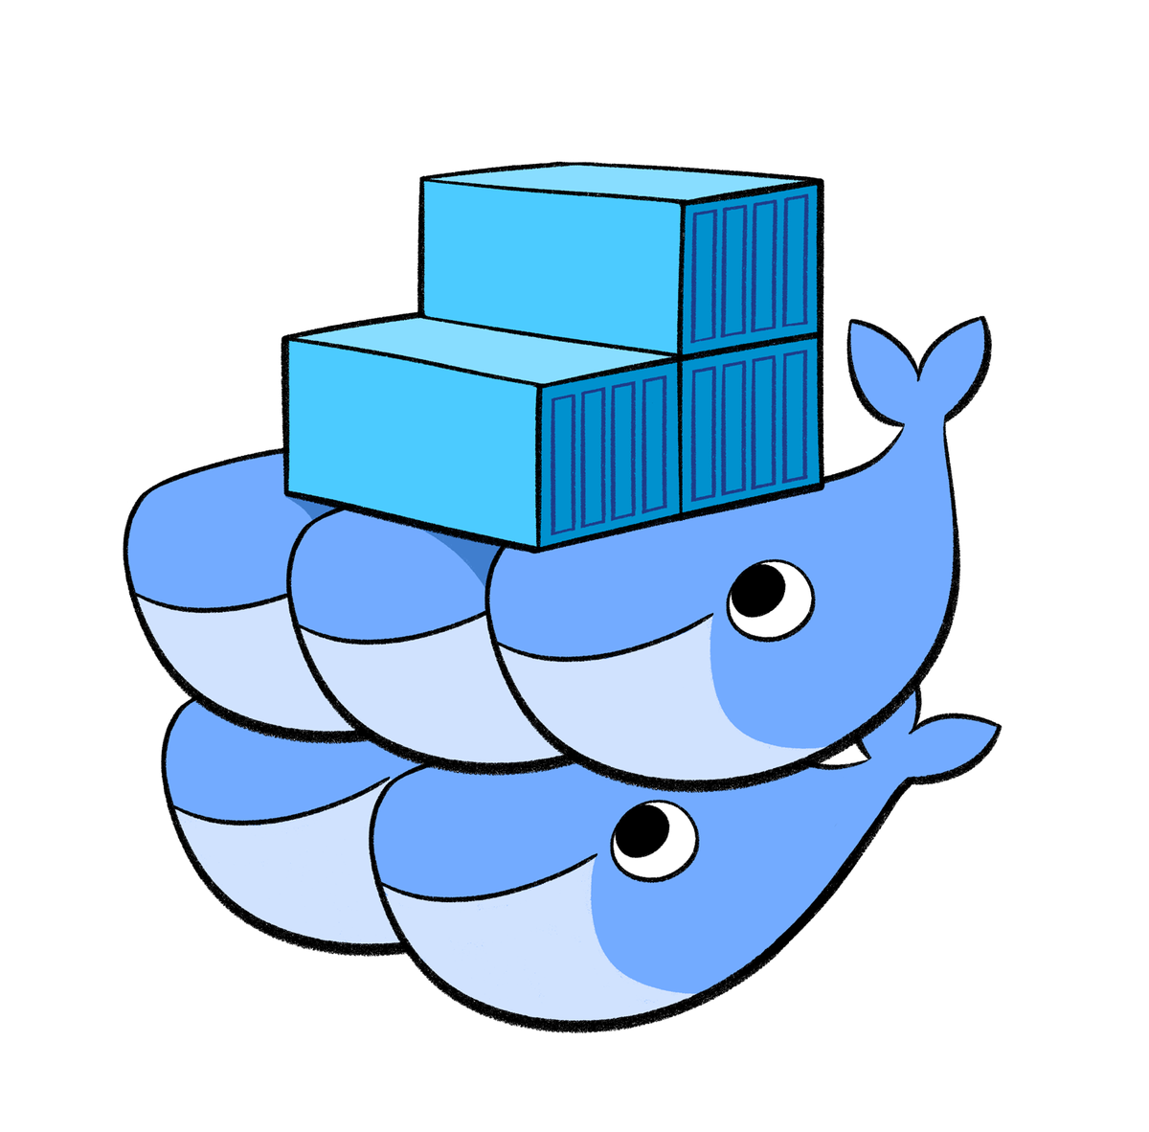


Notes:
So we have all these choices, and we quickly became really overwhelemed
We eventually settled on Rancher
HIGHLIGHT: just do something, don’t get burdened by the many choices

Slide 11
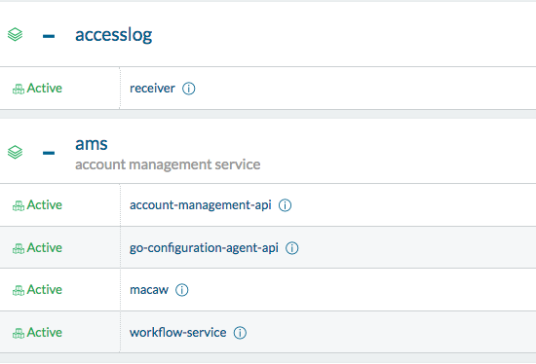
A little bit about Rancher
DLVR uses Rancher 1.6
Similar to Docker Swarm
Our applications are organized by “Stacks”
Each micro-service/container is a “Service”
Separate hosts by “Environment”
Testing Rancher 2.0 (kubernetes)
Notes:
Just a quick overview of Rancher for those who don’t know
Rancher is a really cool open source container orchestrator.
DLVR uses rancher 1.6 or what’s called the “Cattle” orchestrator. Its very similar to docker swarm, leverages very simple docker-compose files. Has a pretty wide catalog of pre-configured services, a built in ha proxy load balancer
Can spin up hosts in various cloud environments if you like
Well organized, simple UI. Excellent for people just getting started with orchestrators, we really recommend it
We can organize our hosts by Environment, and then label the top level applications as stacks
Then within those stacks, each container/micro-service is a called a service
From there we can scale up down, move to other hosts, lots of cool stuff
And even though we avoided Kubernetes when starting this path, Rancher 2.0 is built on k8s and has some really cool features we’re experimenting with

Slide 12
Ok, so Rancher. Now what?
Rancher
Nice GUI
One-click deployments and upgrades
CLI easily automated
Have to duplicate a lot of data
No easy SSH access to hosts
Separated workflows
Salt
Docker modules already there
All of our data already there
We already use it every day
Spin up cloud hosts and have control
No pane of glass for all our containers
We really liked Rancher
MODULE
Notes:
So rancher made it super simple to automate container stack deployments via a nice GUI, one click upgrades and such
It did have a CLI that we could wrap into a shell script or something, again always wanting to be automated
But, we’d have to dupe a lot, if we let rancher spin up the hosts we’d lose *easy* access to the hosts, and we have separate workflows which we thought might become problematic since we use salt on a day to day basis
Or we could use salt exclusively, there’s already modules out there that could do what rancher does
The data is already there
We could spin up cloud hosts and maintain our ssh access
But, we just really like Rancher and didn’t want to give it up that easy
We needed some utility that could bridge the 2, the answer was hey let’s just use a salt module

Slide 13
A little bit about Salt Modules
SaltStacks docs are pretty accurate “Modules are Easy to Write!”
Leverage other python modules that aren’t included in salt
Cross call other salt modules (super helpful!)
cmd.run
state.apply
Use your existing grains and pillar values
Specify different outputs for readability (we’re working on this now)
https://docs.saltstack.com/en/latest/ref/modules/
Notes:
modules are pretty simple to write, essentially it’s just a python scripts that can be called via the salt command
You can use pretty much any python module out there, like ones installed via pip, that isn’t part of salt and integrate it into your custom module
Cross call other salt modules which is incredibly handy, don’t have to make any complex api calls or anything like that, just call what you already know like
cmd.run, state.apply and others
All your data is already there, like your grains and pillar values, so you can call them from w/in the module
Specify different outputs for different functions, which is a future project we’re working on I’ll touch on later

Slide 14
What it solved
Cloud hosts can be salt managed with our SSH keys
Check out salt-cloud!
Environment variables controlled with Pillar and Jinja Variables
No need to duplicate data
Workflow and command-line already familiar to using salt
Retain the nice pane of glass that Rancher gives us
One-click (GUI) options still there if we need them
Notes:
So by doing this it solved all of our concerns about having 2 management environments
We could spin up our cloud hosts using “salt-cloud” which will spin up an ec2 instance, install salt and add to the salt master automatically. Then we’d have full ssh control over the host like any other box
The environment variables w/in the container could be controlled via pillar and other jinja vars
Which means no need to duplicate any data
Our workflow and command line would be the same as our normal workflow using salt
We’d still be able to have that nice pane of glass rancher gives us, along with the UI as an option if we still needed it
HIGHLIGHT LESSON: don’t try and reinvent the wheel, use salt to bridge these gaps

Slide 15
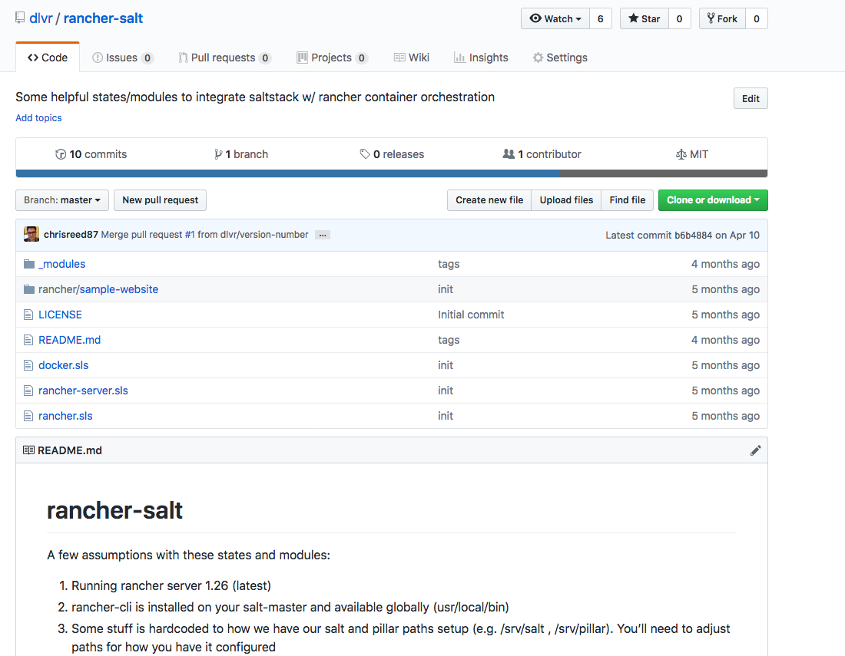
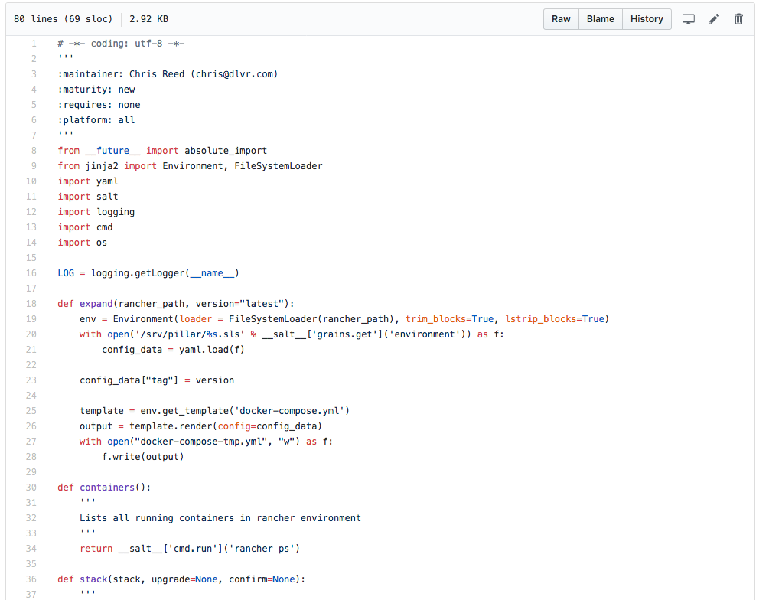
https://github.com/dlvr/rancher-salt
Notes:
So here’s the GitHub link to our salt module
HIGHLIGHT LESSONS: DONT BE AFRAID TO WRITE SOME CODE, IT’S JUST PYTHON

Slide 16
Demo
Notes:
Pages i need open in this order:
https://github.com/dlvr/salt-con-sample-spring-app
https://github.com/dlvr/salt-con-sample-spring-app/tree/master/src/main/resources
https://github.com/dlvr/salt/blob/master/rancher/saltconfdemo/docker-compose.yml
http://phx2-8.phx2.dlvrtest.com:8080/env/1a51084/apps/stacks
http://34.219.141.136:8080/v9001/hello
https://hub.docker.com/r/dlvr/saltconfdemo/tags/
Split screen with a terminal session in phx2-8, rancher config environment set to salt-demo
Backup:
https://docs.google.com/presentation/d/1vweQcE941hWLnQJCAxfe-QMjEP38tF0esNm1srB4A3k/edit#slide=id.g1d382371cc_2_5

Slide 17
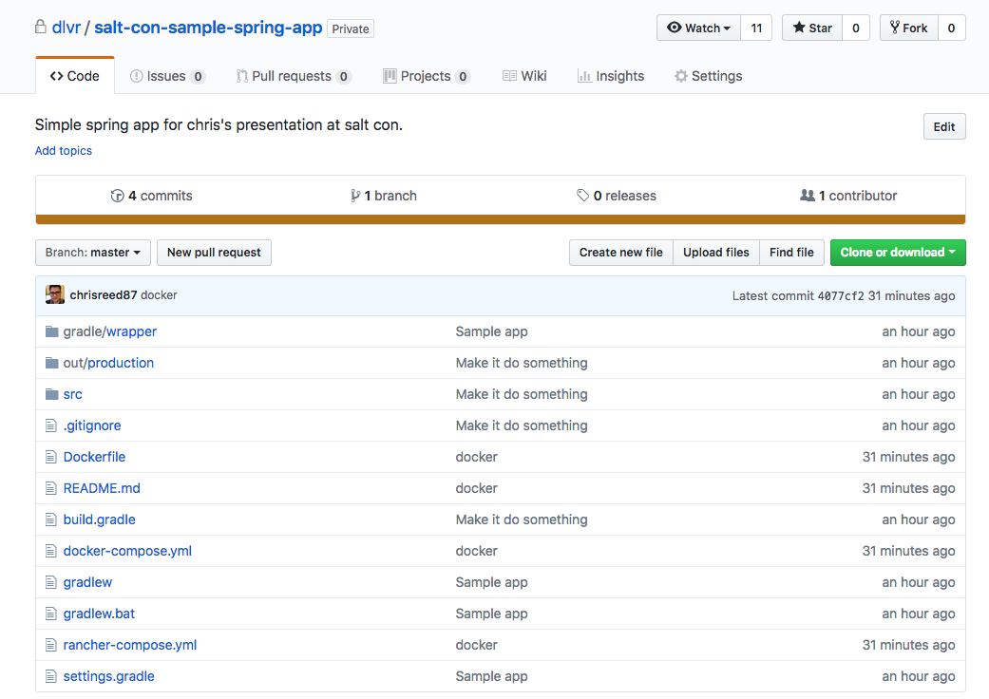
Notes:
So for this demo I’m going to show how we typically spin up a stack and upgrade it using our salt module
So I have this springboot java application that I need to deploy In a rancher environment, for this example LAB

Slide 18
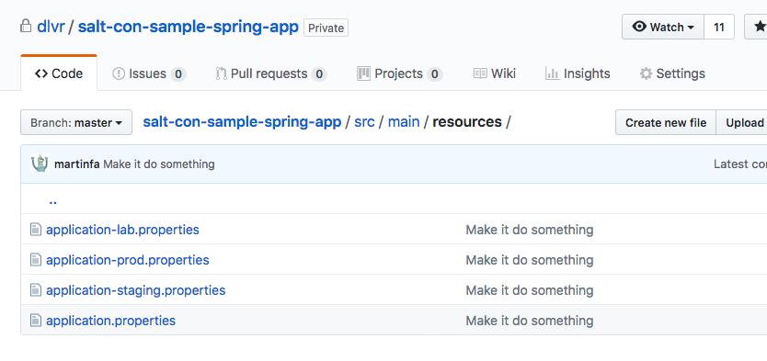
Notes:
And we need to deploy it to multiple environments since each one is a little different, different endpoints
So for this example we just have 3 separate property files which we’ll specifify which one to use based on our salt pillar envionrmnt

Slide 19
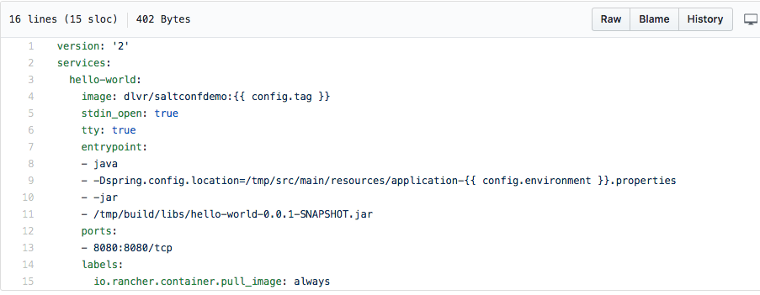
Notes:
So let’s go to our docker-compose file and start building what the stack will look like
Notice the jinja variables, these will be controlled by the module
We set the tag as a variable, I’ll show you why later
And we set what environment we’re running this in

Slide 20
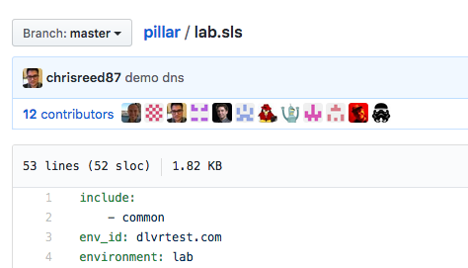
Variables in pillar
Notes:
This just shows that based on our pillar data, we’re deploying this in lab
Notice back in the docker compose file we call specifically “environment”

Slide 21
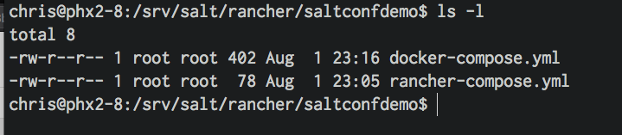
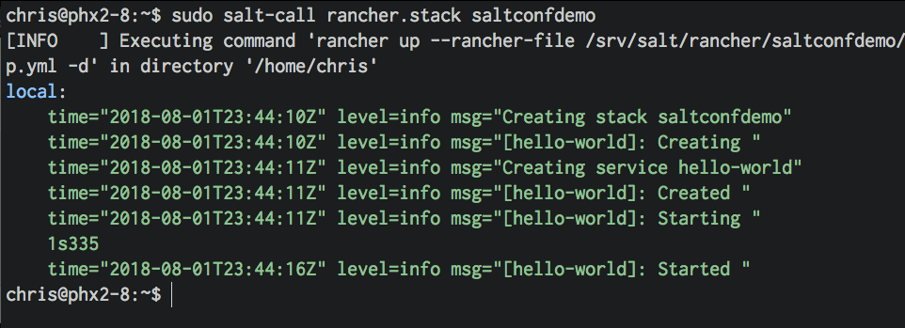
Notes:
So here’s our docker-compose and other rancher files loaded on our salt master
And then we just call the module to create the stack, using the rancher.stack function

Slide 22
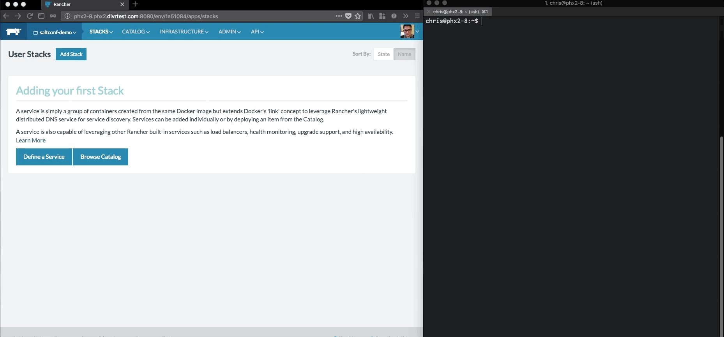
Notes:
Thiis gif shows how the stack is created

Slide 23
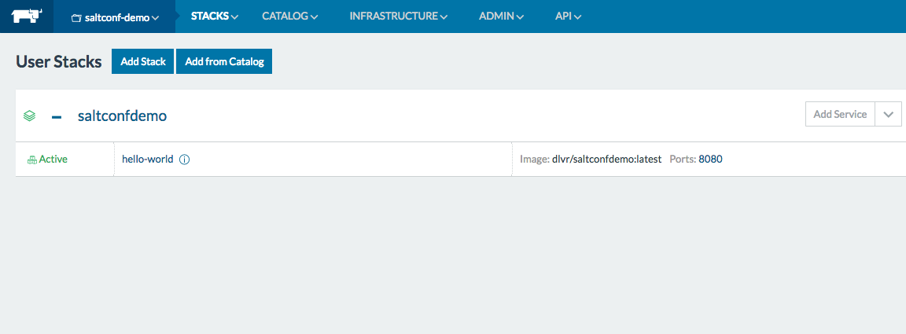
Notes:
So voila here’s our stack in rancher, the tag defaulted to latest since we didn’t specify it, I’ll go back to that in a sec

Slide 24
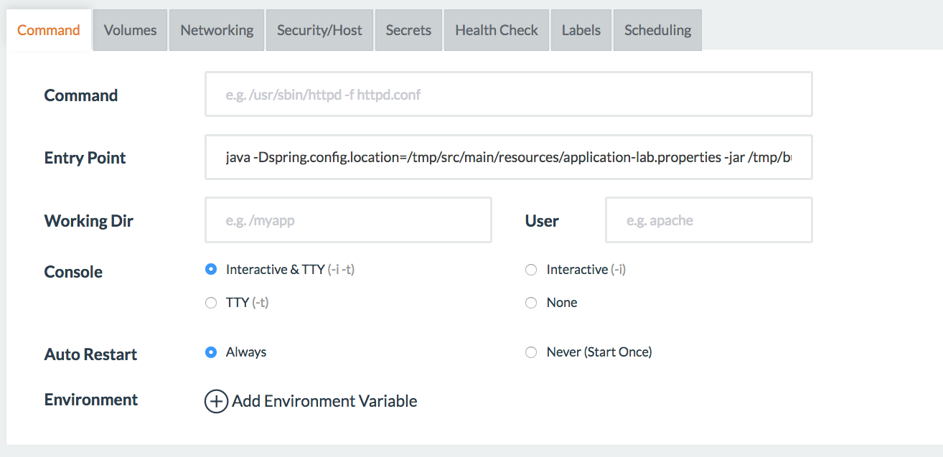
Notes:
And as you can see in the details of the service, it deployed using the lab information based on that pillar variable we called earlier

Slide 25
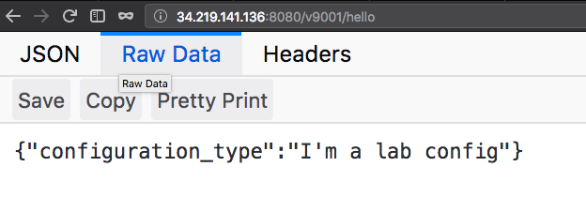
Notes:
And it works

Slide 26
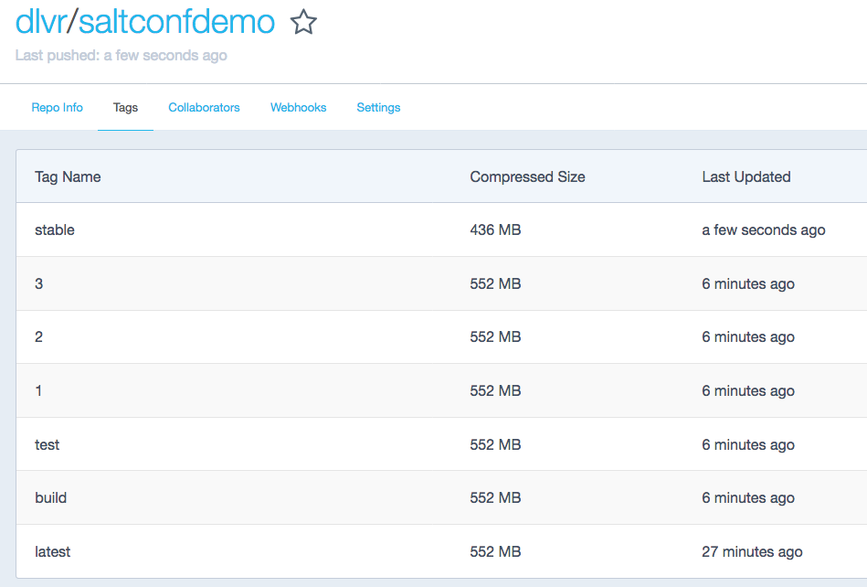
Now let’s upgrade
Notes:
Great so we got our new stack, but we need to upgrade it now
We’ve got all these tags, let’s upgrade to the stable version

Slide 27
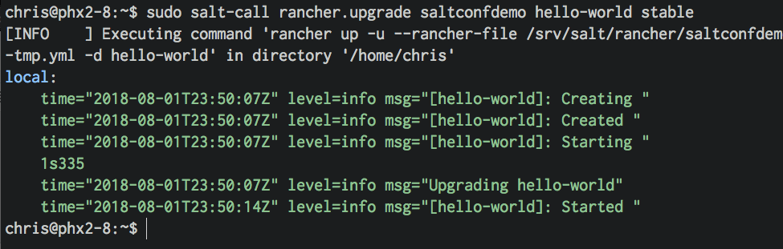
stackname
service
tag name/num
Notes:
So same salt master, we just use the rancher.upgrade function of the custom module
The syntax works like this
Rancher.upgrade is the function
Saltconfdemo is the stack name
Hello-world is the service we want to upgrade
And then we specify what tag version or number we want to go to in this case stable

Slide 28
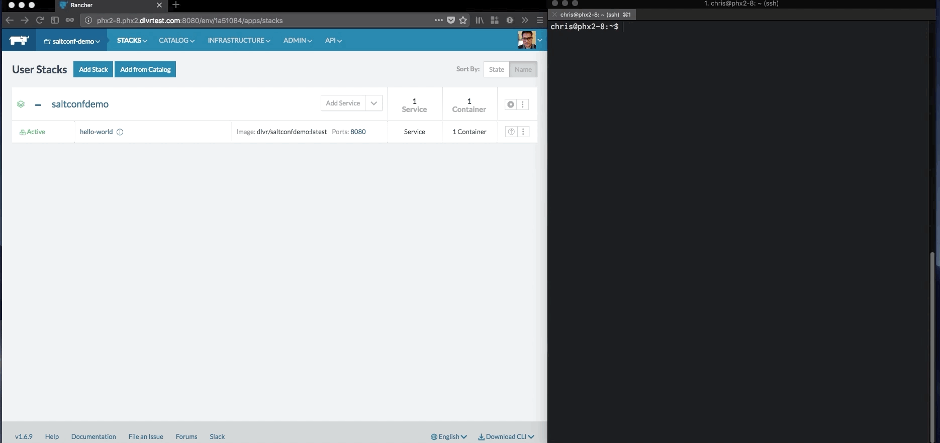
Notes:
So here’s another gif of it in action

Slide 29
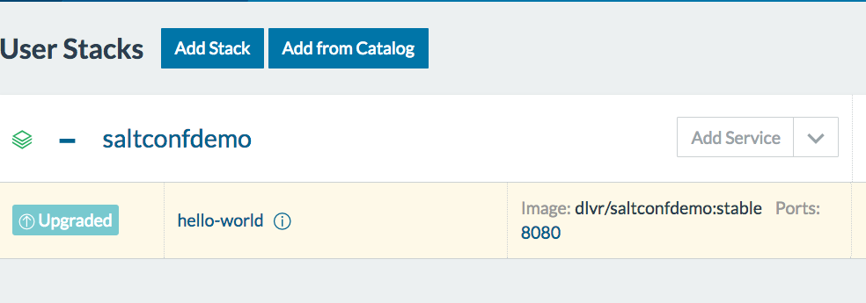
Notes:
And there we go so you can see our application in now upgraded, you can see the stable version specified

Slide 30
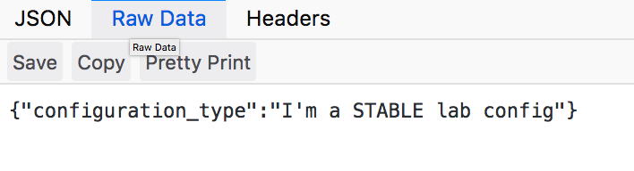
Notes:
And going back to the webpage our changes are reflected

Slide 31
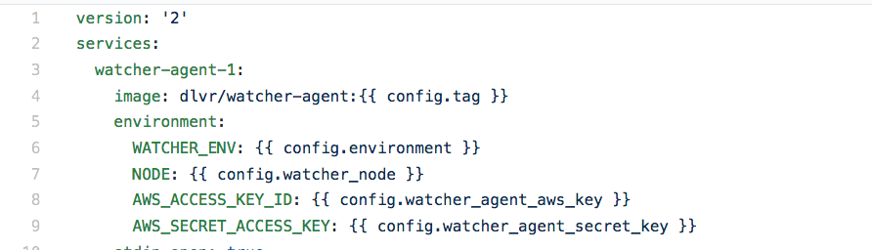
Other examples of pillar variables
Notes:
So that’s like a really basic example of what you can do with it, but you can then just start using it even more complex
Here’s an example docker-compose setup with more variables in pillar, we’re varying the tag, environment, what node it is, what AWS keys to use, etc.

Slide 32
Other functions
Upgrade the entire stack
`rancher.stack demo upgrade`
Rollback and/or confirmation
`rancher.upgrade hello-world 10 rollback`
`rancher.upgrade hello-world 10 confirm`
See all containers running across all of rancher
`rancher.containers`
Similar to `docker ps`
For loops: {% for container in [‘1’,’2’,’3’] %}
Keep your docker-compose file short and sweet

Slide 33
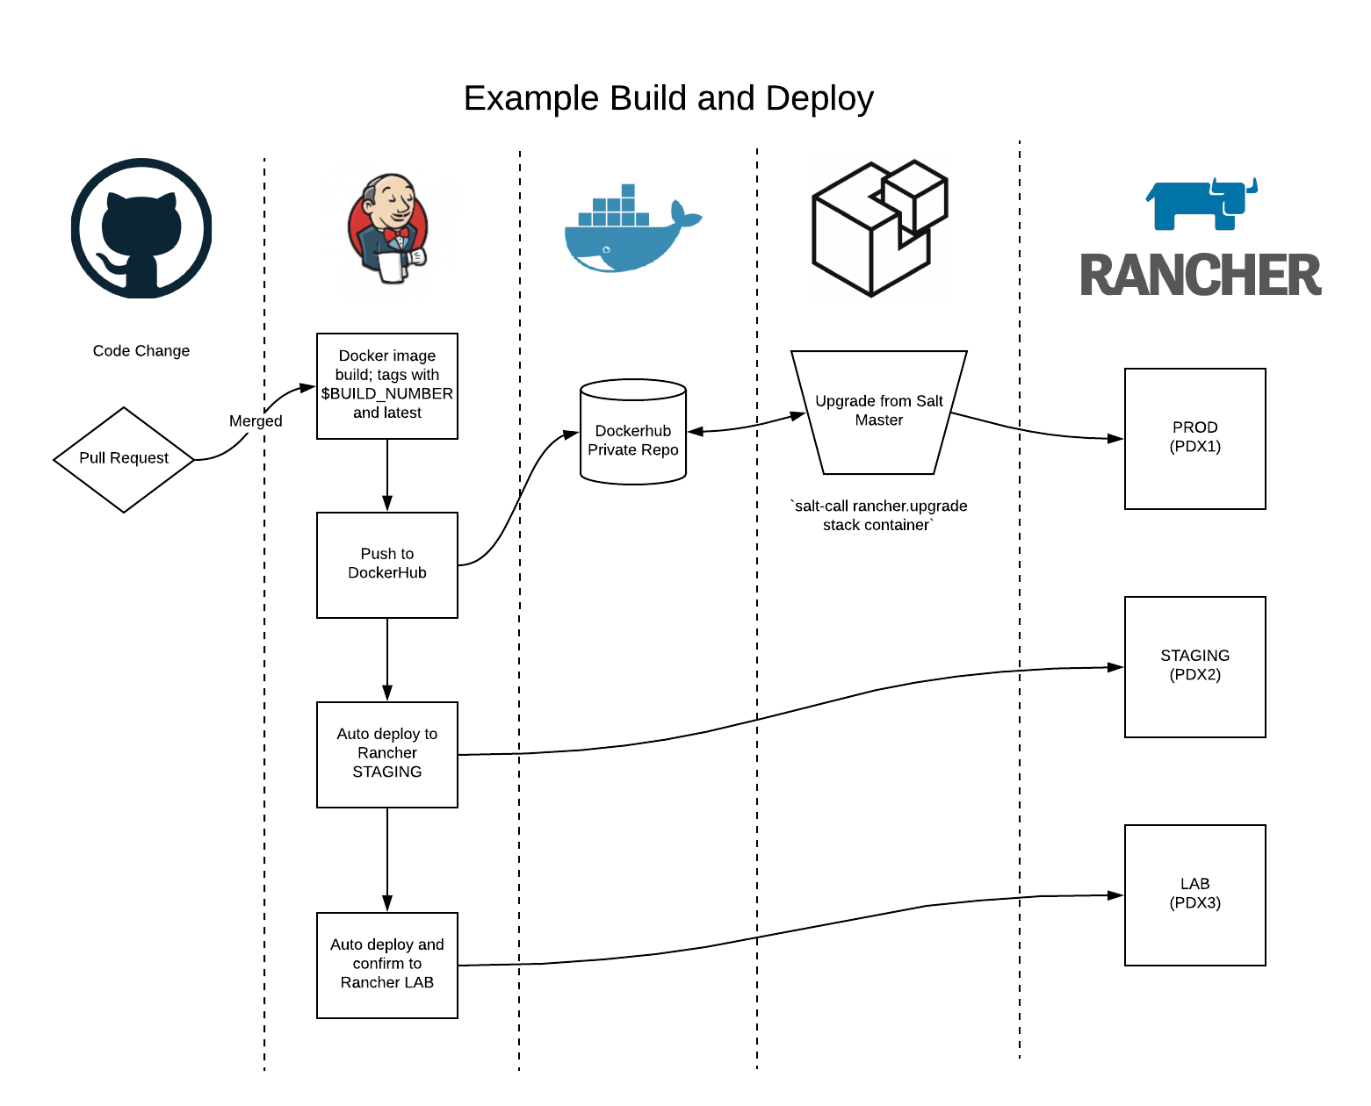
Notes:
So this is just an example workflow that we ended up with and it’s been running really nice for us

Slide 34
Lessons Learned
Don’t try and reinvent the wheel
Think of salt like the glue that can bring everything together
Don’t be afraid to write some code
Just do something
Share the love
Notes:
Start with what you use and know
You already use salt everyday, you already have all the data handy, use it
Bridge your operations gaps with the tools you already know, and expand from there. Dont’ re-invent the wheel
Think of salt like the glue that can bring everything together
There’s probably MANY things w/in saltstack that you’re not using. Browse through the salt docs, look at existing modules, think outside the box while staying within your salt world
Don’t be afraid to write some code
Salt modules, runners are easier to write than you think. And i’m not a developer at all and in a few hours I had a blueprint of this working
Just do something
Try not to get bogged down by the burden of choice by the gazillion ways that you could do things. Again start with what you know, leverage salt to bridge those gaps, and expand from there
Share the love
We couldn’t find a specific solution to what we needed, so we wrote it and wanted to share it with the salt community. That’s why these conferences are so great because we can all share what we’ve done and learned, so do the same

Slide 35
Moving Forward
(more salt modules, formatters and runners)

Slide 36
Custom highstates & deploys
Turning this ---------------------------------------------------> Into this
Name: nginx-arc - Function: service.running - Result: Clean Started: - 20:33:30.691294 Duration: 54.571 ms
Name: /opt/dlvr/nginx-cache/conf/cache.conf - Function: file.managed - Result: Clean Started: - 20:33:30.746133 Duration: 467.489 ms
Name: /opt/dlvr/nginx-cache/conf/location.conf - Function: file.managed - Result: Clean Started: - 20:33:31.213913 Duration: 14.806 ms
Name: /opt/dlvr/nginx-cache/conf/static.conf - Function: file.managed - Result: Clean Started: - 20:33:31.228986 Duration: 9.865 ms
Name: /opt/dlvr/nginx-cache/conf/ppass.conf - Function: file.managed - Result: Clean Started: - 20:33:31.239053 Duration: 9.952 ms
Name: /opt/dlvr/nginx-cache/conf/fallback.conf - Function: file.managed - Result: Clean Started: - 20:33:31.249205 Duration: 3.578 ms
Name: /opt/dlvr/nginx-cache/conf/geo_cache.conf - Function: file.managed - Result: Clean Started: - 20:33:31.252992 Duration: 1407.204 ms
Name: /opt/dlvr/nginx-cache/conf/set_cache.conf - Function: file.managed - Result: Clean Started: - 20:33:32.660772 Duration: 74.872 ms
Name: /opt/dlvr/nginx-cache/conf/purge-cache.conf - Function: file.managed - Result: Clean Started: - 20:33:32.735937 Duration: 11.194 ms
Name: /opt/dlvr/nginx-cache/conf/cache-stats.conf - Function: file.managed -
And on and on and on and on…..
chris@master:$ sudo salt-run newdeploy.config
running customer config push
No changes for datadog.sls
No changes for cache-account-configs.sls
No changes for pems.sls
No changes for watcher-agent.sls
No changes for arc-account-configs.sls
No changes for lua.sls
No changes for accountData.sls
No changes for remove-configagent.sls
No changes for arc-cache-configs.sls
Notes:
So since we highstate every day we see a lot of this. Really long, piped, one-liner commands that we have to wrap in a shell and then we get this output that we have to filter out. Well we’re experimenting with additional salt modules, formatters to clean the output up, and using salt-runners to wrap the entire deployment into 1 short and sweet command

Slide 37
Thanks!
github.com/dlvr/rancher-salt
dlvr.com

